Slide 1
Analysis on Energy Consumption
BUAN 6340.003 F19 – Group 3.6
Siddhartha Shankar, Meenakshi Shastri, Ajay Samala

Slide 2

Overview
Attribute Name | Description | Dimension
Date time | Time of capture of data
Appliances | Energy use of appliances | Wh
Lights | Energy use of light fixtures in the house | Wh
T1 | Temperature in kitchen area | Celsius
RH_1 | Humidity in kitchen area | %
T2 | Temperature in living room area | Celsius
RH_2 | Humidity in living room area | %
T3 | Temperature in laundry room area | Celsius
RH_3 | Humidity in laundry room area | %
T4 | Temperature in office room | Celsius
RH_4 | Humidity in office room | %
T5 | Temperature in bathroom | Celsius
RH_5 | Humidity in bathroom | %
T6 | Temperature outside the building (north side) | Celsius
RH_6 | Humidity outside the building (north side) | %
T7 | Temperature in ironing room | Celsius
RH_7 | Humidity in ironing room | %
T8 | Temperature in teenager room 2 | Celsius
RH_8 | Humidity in teenager room 2 | %
T9 | Temperature in parents room | Celsius
RH_9 | Humidity in parents room | %
To | Temperature outside (from Chievres weather station) | Celsius
Pressure | From Chievres weather station | mm Hg
RH_out | Humidity outside (from Chievres weather station) | %
Wind speed | From Chievres weather station | m/s
Visibility | From Chievres weather station | Km
Tdewpoint | From Chievres weather station | Â°C
rv1 | Random variable 1 | nondimensional
rv2 | Random variable 2 | nondimensional
Data Description
Data of a particular house was captured using IoT Sensors and averaged out for an interval of every 10 minutes over 4.5 months.
Consists of 19735 records and 29 attributes.
Dependent variable (y) is Appliances, energy use in Wh. The main features are temperature, humidity and pressure.
Source for the DataSet : UCI ML Library
Objective
Implementing supervised learning models to estimate Energy Usage of Appliances and predict household as high and low energy consumption based on appliances energy use considering temperature, humidity and weather attributes.

Slide 3


Data Exploration

Slide 4
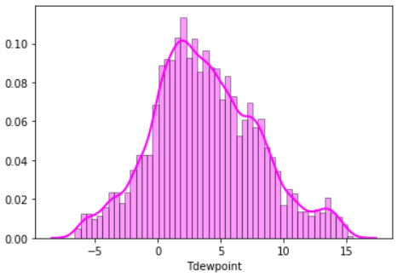
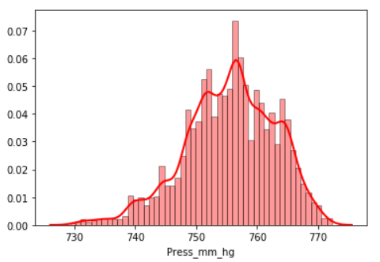
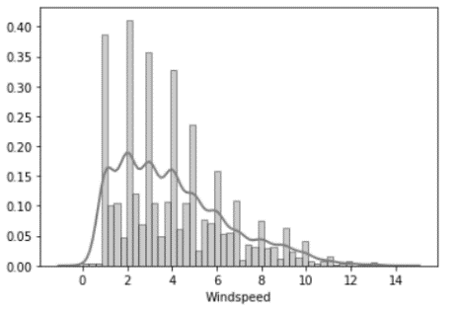
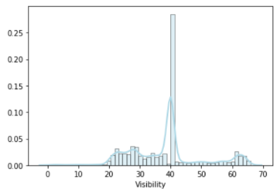
Weather Attributes
‘Visibility’ and ‘Windspeed’ are skewed. However, Pressure and Dewpoint follow Normal distribution

Slide 5
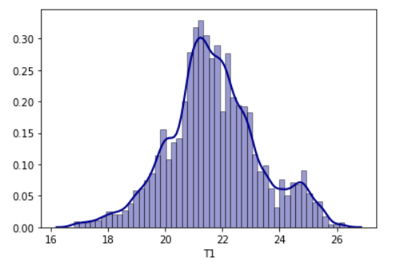
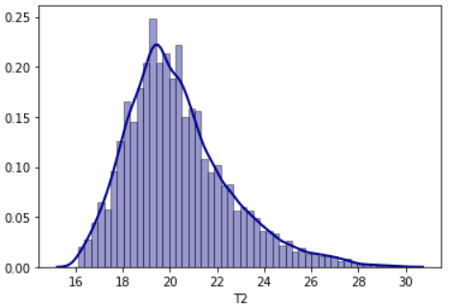
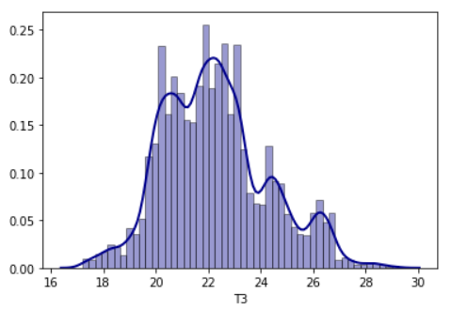
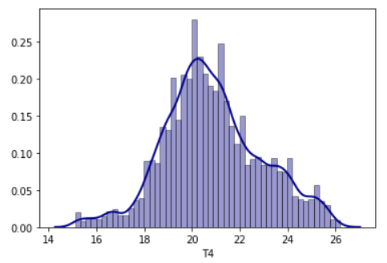
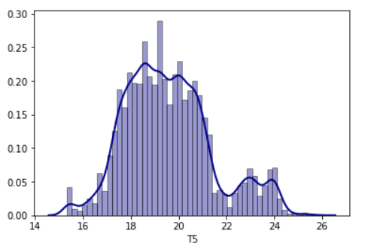
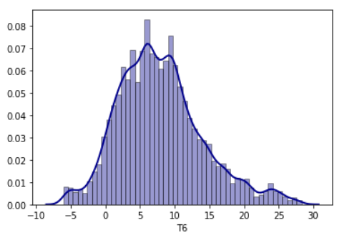
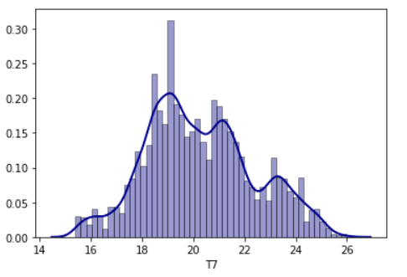
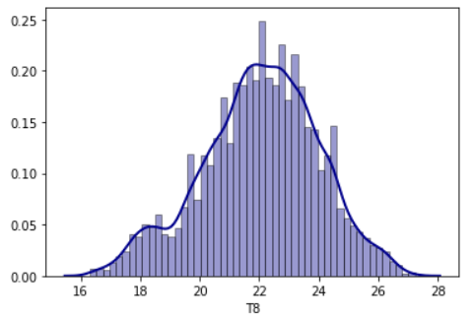
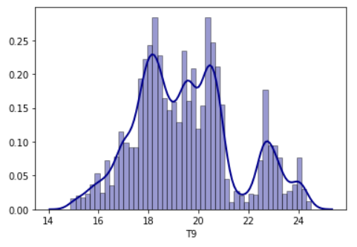
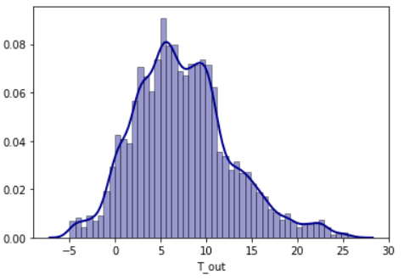
Temperature Attributes
All temperature records show normal distribution, except T9 (Temperature in parents’ room).

Slide 6
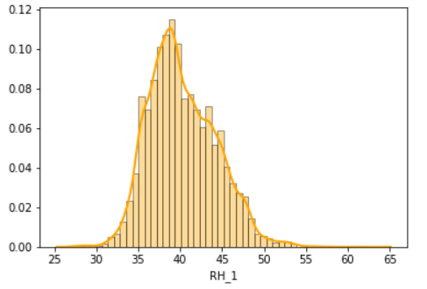
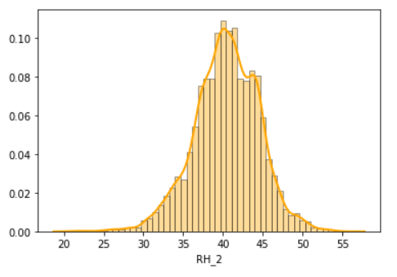
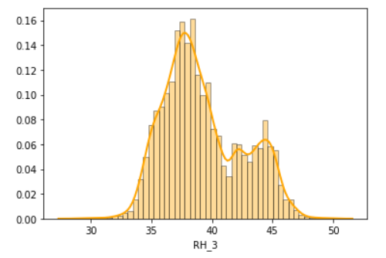
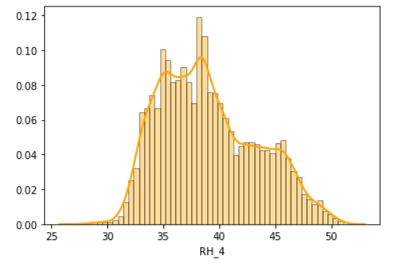
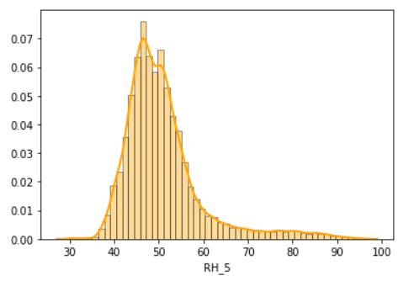
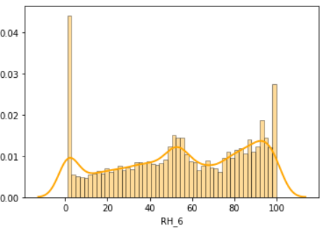
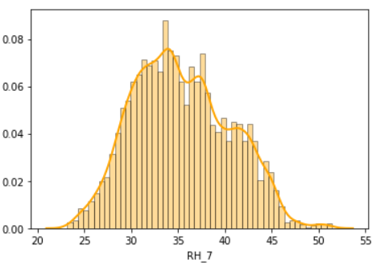
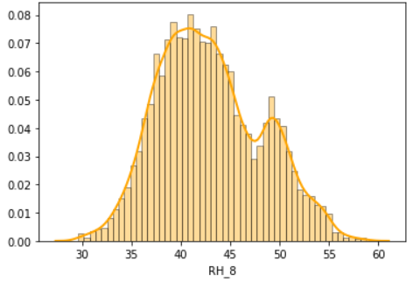
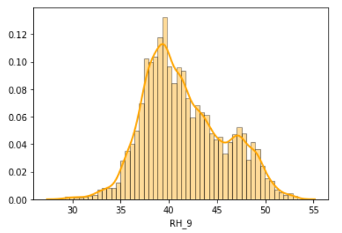
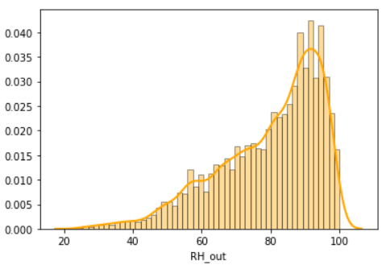
Humidity Attributes
Except RH_6 and RH_out, all records follow a Normal distribution. Since, RH_6 and RH_out both shows outside humidity. That means, all inside home humidity records follow Normal distribution

Slide 7

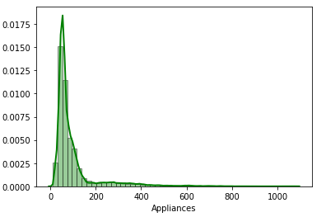

Dependent Variable : Appliances
Summary Statistics
count | 19735.000000
mean | 97.694958
std | 102.524891
min | 10.000000
25% | 50.000000
50% | 60.000000
75% | 100.000000
max | 1080.000000
‘Appliances’ is skewed right which shows that there are a greater number of low energy consumption records than high energy consumption records.

Slide 8
Feature Selection
Feature Range
Temperature | -6 to 30 deg
Humidity | 1 to 100 %
Windspeed | 0 to 14 m/s
Visibility | 1 to 66 km
Pressure | 729 to 772 mm Hg
Appliance Energy Usage | 10 to 1080 Wh
There are no missing values in the data. Hence, no imputation is required.
The feature ‘Light’ is removed as we are interested in estimating the energy use of appliances.
The random variables ‘rv1’ and ‘rv2’ are removed as both have approx. same values for all the records.
The ‘Date’ column is removed as it provides the consumption information on a given date.
‘T6’ & ‘T_Out’ both shows outside temperature. Hence, ‘T6’ is removed.

Slide 9
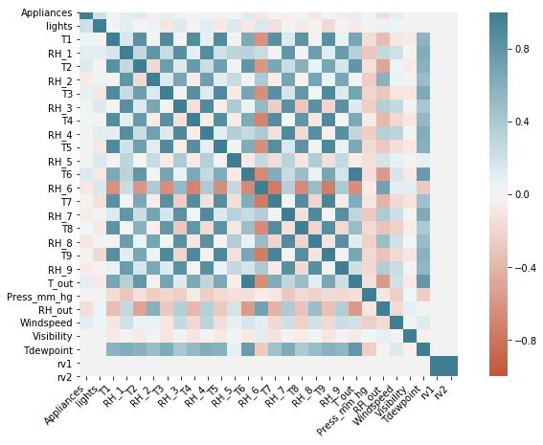
Correlation Matrix
T1-T9 and T_out are positively correlated with the target variable ‘Appliances’. T9 is highly correlated with T3,T5,T7,T8. Hence, T9 is removed from the dataset.
There are no significantly high correlation records (> 0.9) for humidity sensors.
Visibility, Tdewpoint, Press_mm_hg have low correlation values with target variable.
No features have a linear relationship with the target variable.
Based on the above observations, 'date', 'lights', 'T6', 'RH_6', 'T8', 'RH_8', 'T9', 'RH_9', 'rv1', 'rv2', 'Visibility' columns are removed from the dataset.

Slide 10
Linear Regression: Estimating the Energy Usage of Appliances

Slide 11
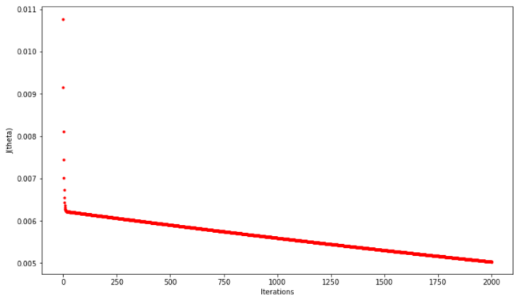
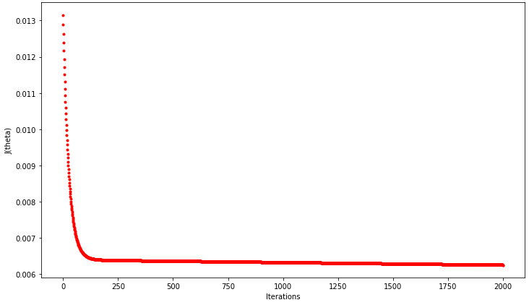
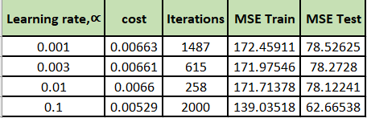
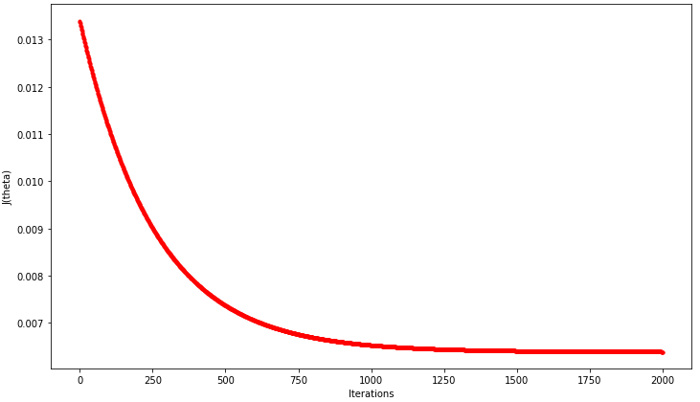
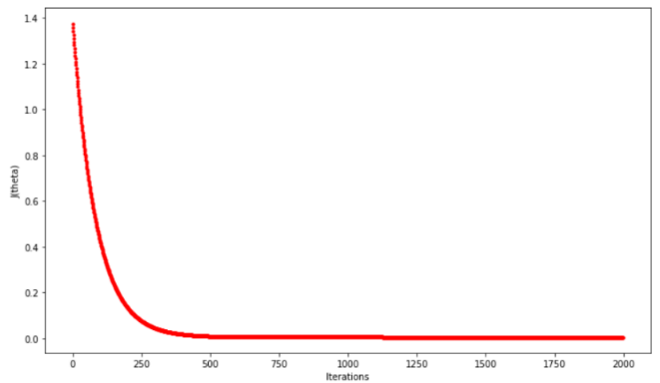
Experimenting with parameters for linear regression: LEARNING RATE ∝ and describing error\accuracy results for train and test sets as a function of ∝
∝ = 0.1
∝ = 0.01
As the value of ∝ decreases, the curve slowly moves towards zero rather than suddenly dropping as the cost function approaches its minimum value. Hence, Learning Rate (∝) = 0.001 is the optimal value provided fixed convergence threshold of 0.0000001 and Iterations = 2000.
∝ = 0.001
∝ = 0.003
Notes:
0.001

Slide 12
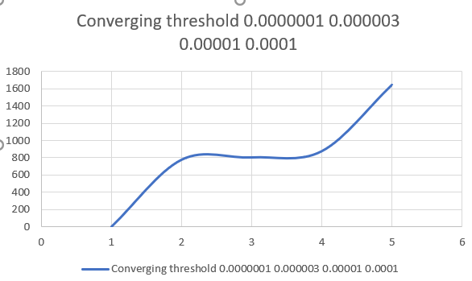
Experimenting with parameters for linear regression: CONVERGING THRESHOLD and describing error results for train and test sets as a function of threshold.
Converging Threshold | Cost | Iterations | MSE Train | MSE Test
0.0000001 | 0.006631 | 1487 | 172.45911 | 78.52625
0.000003 | 0.007387 | 572 | 192.34223 | 87.48112
0.00001 | 0.00917 | 263 | 240.75897 | 108.6567
0.0001 | 0.01373 | 1 | 365.23942 | 162.6253
As per the above table, it is evident that as the value of converging threshold decreases no. of iterations increases. Also, Mean Square Error for train and test data decreases with decrease in converging threshold value. Additionally, cost function is minimum for the lowest converging threshold.
Thus, converging threshold = 0.0000001 is the optimal value as it gives the lowest value of MSE.

Slide 13

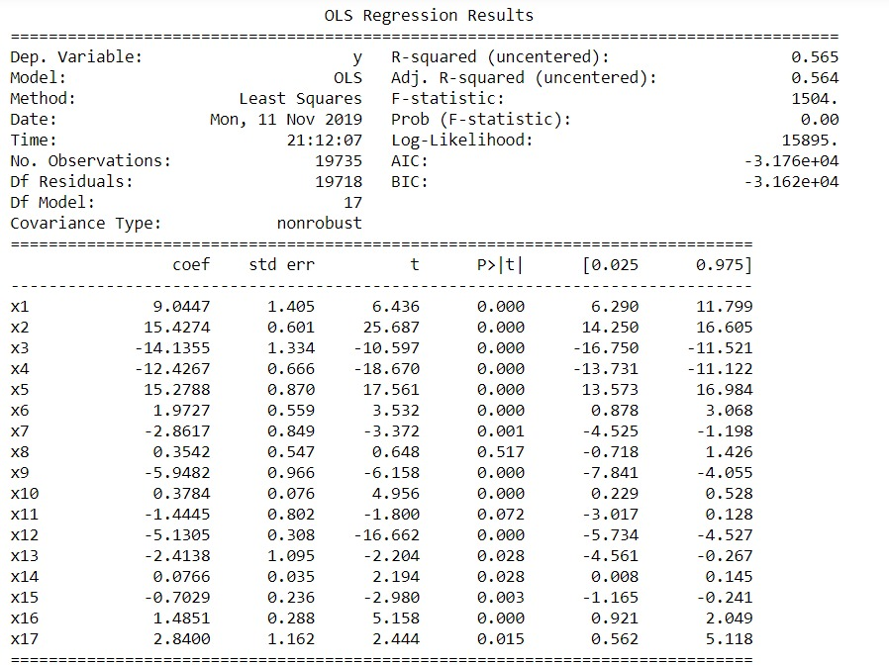

Linear Regression Summary Statistics
Optimal values of thetas for learning rate ( ∝ = 0.001), converging threshold = 0.0000001 are :

Slide 14
Converting the problem into binary classification: High(1) and Low(0) Consumption Categories

Slide 15
The Approach
To convert this problem into a binary classification problem we convert the target variable - ‘Appliances’ into categorical variables based on energy consumption as outlined below
Summary stats of Appliances
count | 19735.000000
mean | 0.214492
std | 0.410480
min | 0.000000
25% | 0.000000
50% | 0.000000
75% | 0.000000
max | 1.000000
If the energy consumption of ‘Appliances’ <= 100 Wh, it is assigned value 0; else 1.
Before splitting the dataset into 70:30 ratio, dataset is scaled as per = (X - X_{mean}) / (standard deviation) with sklearn module.
We would like to minimize the false-positive rate (FPR) as we don’t want to predict that a household as high consumption if it isn't actually. Hence, ROC (Receiver Operating Characteristic) curve, AUC (Area Under Curve ) and Recall is preferred as the performance metric.

Slide 16
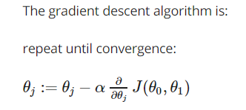
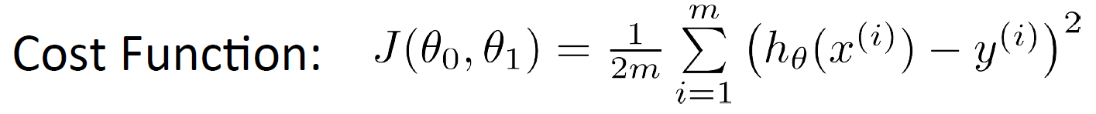
Algorithm Preparation and Parameter Tuning
We build our model over training datasets and test its accuracy over Test data. Before splitting the dataset into 70:30 ratio, dataset was scaled as per = (X - X_{mean}) / (X_{max} - X_{min}) with sklearn module. No. of Training examples = 13814 and No. of Test data points = 5921.
Algorithm is designed based on cost function of sum of squared errors mentioned below.

Slide 17
Various Models Evaluated
Logistic Regression
Support Vector Machines: (kernel= Gaussian ‘rbf’)
Decision Tree
Ada Boost Classifier
Random Forest
KNN(k=5)
Keras ANN

Slide 18
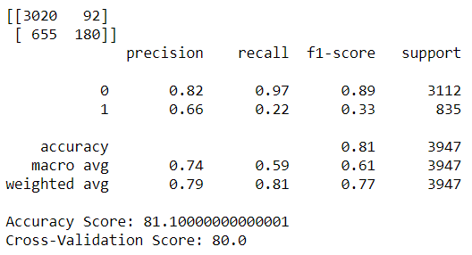
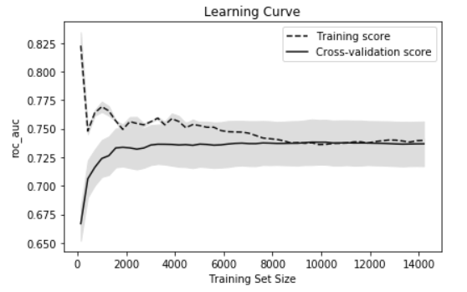
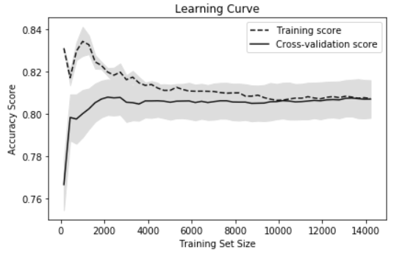
Logistic Regression
Classification Report and Confusion Matrix
Learning curves to evaluate model performance
Results
Model Accuracy | 81.10%
Cross validation (CV) score | 80.0%
AUC | 0.74

Slide 19
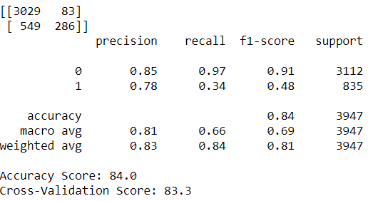
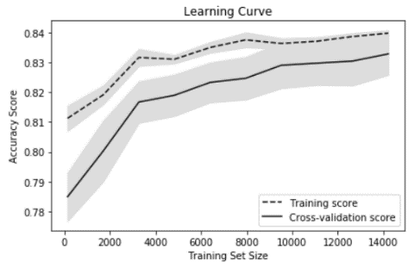
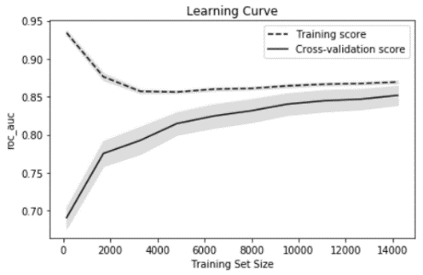
Support Vector Machines: (kernel= Gaussian ‘rbf’)
Classification Report and Confusion Matrix
Learning curves to evaluate model performance
Results
Model Accuracy | 84.0%
Cross validation (CV) score | 83.3%

Slide 20
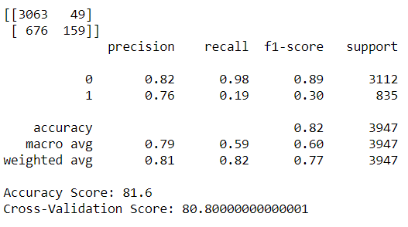
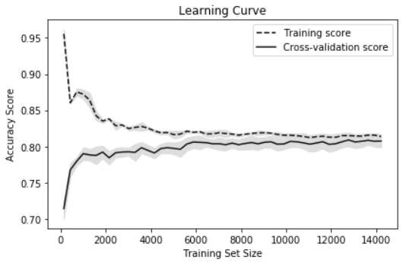
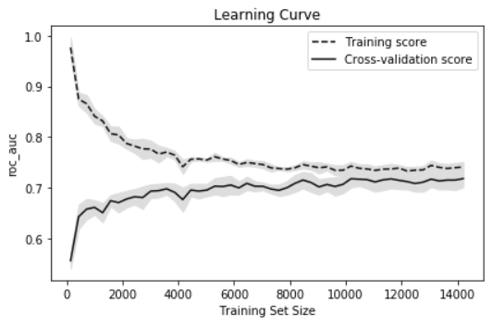
Decision Tree Classifier
Classification Report and Confusion Matrix
Learning curves to evaluate model performance
Results
Model Accuracy | 81.6%
Cross validation (CV) score | 80.8%
AUC | 0.73

Slide 21
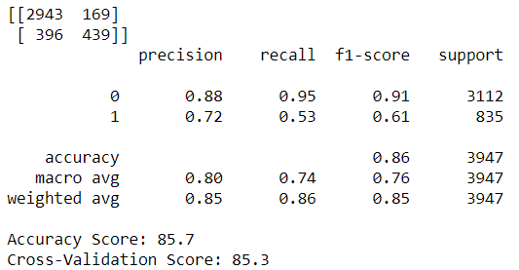
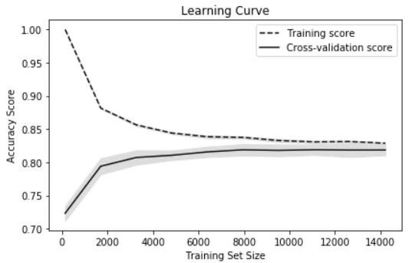
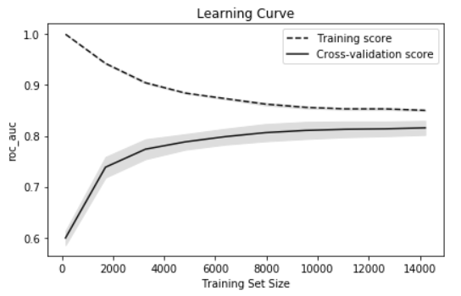
AdaBoost Classifier
Classification Report and Confusion Matrix
Learning curves to evaluate model performance
Results
Model Accuracy | 85.7%
Cross validation (CV) score | 85.3%
AUC | 0.81

Slide 22
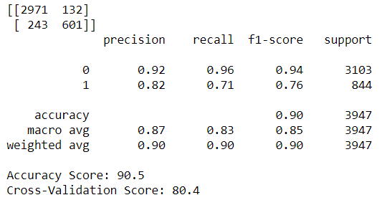
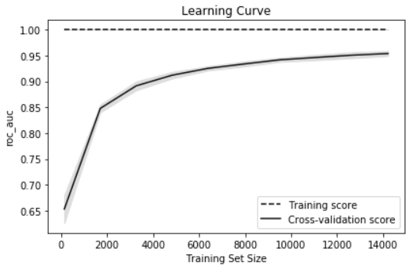
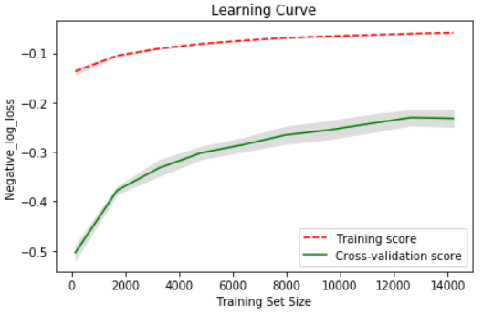
Random Forest Classifier
Classification Report and Confusion Matrix
Learning curves to evaluate model performance
Results
Model Accuracy | 90.5%
Cross validation (CV) score | 80.4
AUC | 0.95

Slide 23




K Nearest Neighbor (k=5)
As ‘k’ increases, bias increases but variance decreases. This is because, training accuracy increases with increase in value of k. To counteract this, 10-fold cross-validation is used. The best k is the one that minimizes the misclassification rate for the validation dataset. Below is the plot which shows testing accuracy with the value of k for KNN for various distance metric
As per the above plots, k =5 gives better relative accuracy. Hence, k = 5 is used for KNN for energy dataset.
Distance Metric = ‘Euclidean’ and ‘Minkowski’ both performs same and better than Distance metric = ‘Manhattan’ based on False Positive rate (FPR). Moreover, Distance metric = ‘Euclidean is most commonly used for KNN. Hence, KNN with k=5 and distance metric = ‘Euclidean’ is used for energy dataset

Slide 24



K Nearest Neighbor (k=5)
Classification Report and Confusion Matrix
Learning curves to evaluate model performance
Results:
Learning curve suggests that training accuracy is higher than testing and gradually converging as the training set size increases i.e. KNN model with k=5 is free from under- or over-fitting.

Slide 25




TensorFlow 2.0 Keras Neural Network Classifier
Classification Report and Confusion Matrix
Learning curves to evaluate model performance
Results:
Based on the above metrics, Keras model with ‘relu’ activation function performs best for our dataset compare to ‘tanh’ and ‘sigmoid’ activation function based on False Positive Rate (FPR) and Recall (‘0’) = 95%.

Slide 26


Cross-Validation Score based on accuracy
ROC curve and AUC of different classifier models
Cross- Validation score helps us to validate the model. Higher the Cross-Validation score, better the model is in performing classification.

Slide 27

Comparison Between Classification Models
Models | Logistic | SVC (kernel = 'gaussian') | Decision Tree | Random Forest | AdaBoost Classifier | KNN (k = 5) | Keras ('relu') NN
Accuracy (%) | 80.9 | 83.5 | 80.6 | 90.5* | 84.8 | 88.8 | 80.8
Precision ('0') (%) | 82 | 84 | 81 | 92* | 87 | 92 | 82
Recall ('0') (%) | 96 | 97 | 99* | 96 | 94 | 94 | 97
False Positive | 112 | 95 | 29* | 132 | 177 | 181 | 87
True Positive | 201 | 287 | 107 | 601* | 420 | 582 | 175
AUC | 0.73 |  | 0.7 | 0.95* | 0.88 | 0.92 | 0.76
As discussed earlier, we would like to minimize false positive rate (FPR) as we don’t want to predict high consumption if it is not actually.
Hence, as per the table and graph, we can say that Random Forest performs best based on AUC, Accuracy, Precision, FPR at TPR = 0.99 for the Energy Dataset.

Slide 28

Important Features as per Random Forest Classifier
As per the Random Forest Classifier, humidity is the most significant factor which explains most of the variation in y (Appliance Energy usage).

Slide 29
Conclusion
As per the correlation matrix, ‘Humidity’ attribute is positively correlated with target variable and have significantly higher values. Hence, ‘Humidity’ explains a lot of variation in energy consumption by Appliances which is evident from our analysis as well.
As there are no features having a linear relationship with the target variable. Linear Regression do not perform well with this data. Moreover, prediction can be improved with time series where we would have predicted future consumption based on past consumption.
Prediction can be improved if we have access to demographic data such as family income, family size, geographical location etc.
As per the Density plot and histogram, it is evident that target variable ‘Appliances’ is not normally distributed. Hence, using other functional form of target variable may predict better energy consumption by Appliances.
The energy consumption is generally higher during weekends. So, creating binary variable such as weekdays and weekends will provide better insights and can have significant effect on prediction.

